Slide 1

BIKE SALES INDIA
SALES ANALYST PROJECT
ANALYST OF BIKE SALES
By = Vikas Kumar Gupta

Slide 2
SALES ANALYST PROJECT
Information The Project Overview
The Name of this data set Bikes Sales India.
This Project focuses on analysing sales data using SQL for data extraction and Power BI for Visualization.
=> Objective: To identify key Sales, product performance, and customer insights.
Tools Used
MySQL – For Querying and cleaning row data and Information
Power BI – For Creating Interactive Dashboards

Slide 3
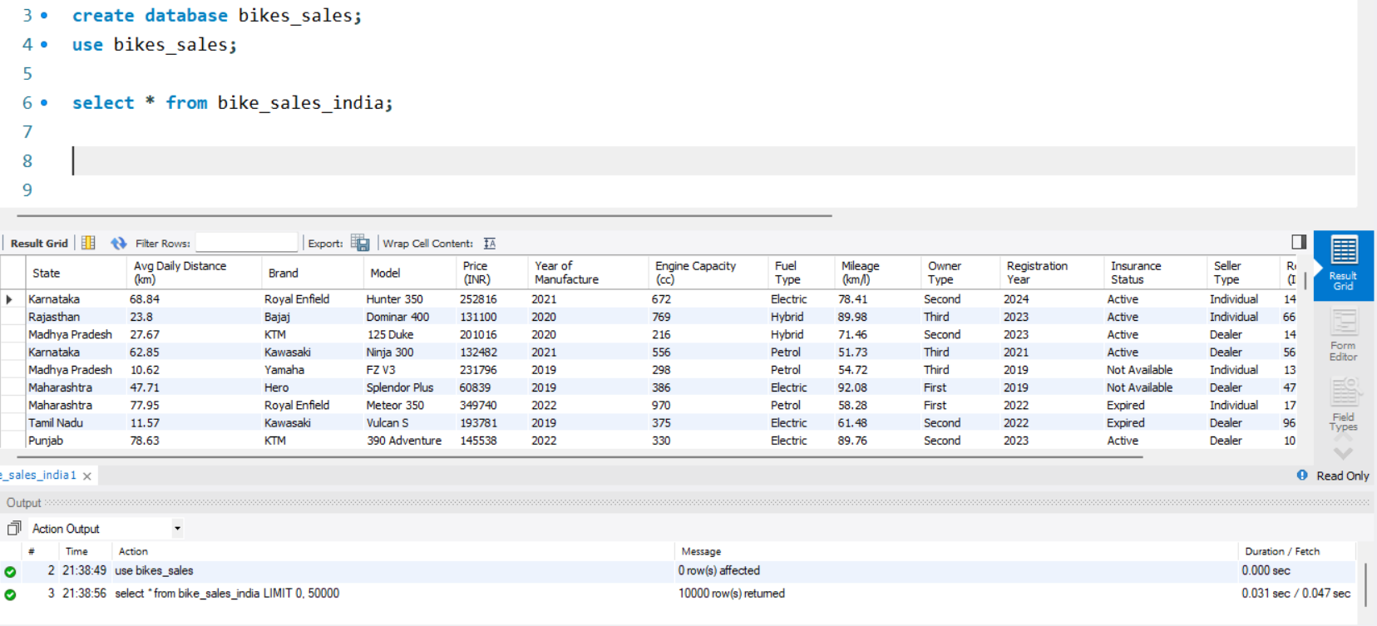
SALES ANALYST PROJECT
Data Preparation (SQL Part)
Removed Null and Duplicate records
Joined Multiple Table using Join
Used Group By, Order By, and CASE Statement for business logic
Create a Databased and Use Tables

Slide 4
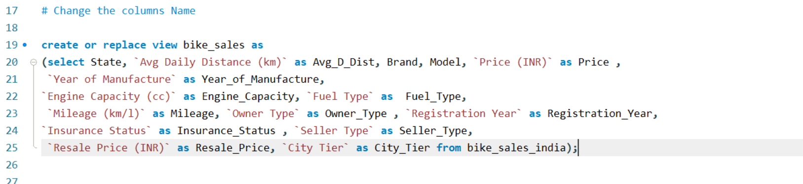
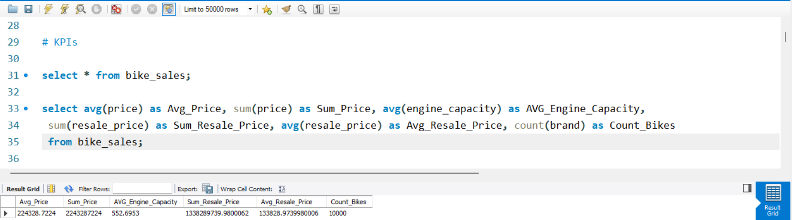
SALES ANALYST PROJECT
Change the columns Name
KPIs

Slide 5
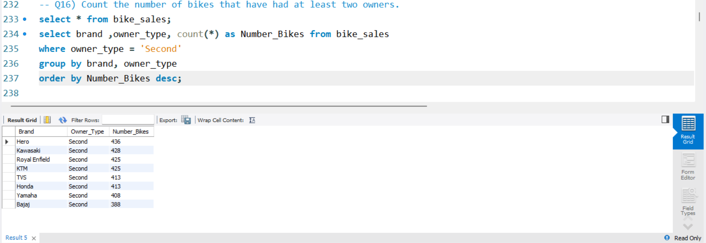
SALES ANALYST PROJECT
Count the number of bikes that have had at least two owners.

Slide 6
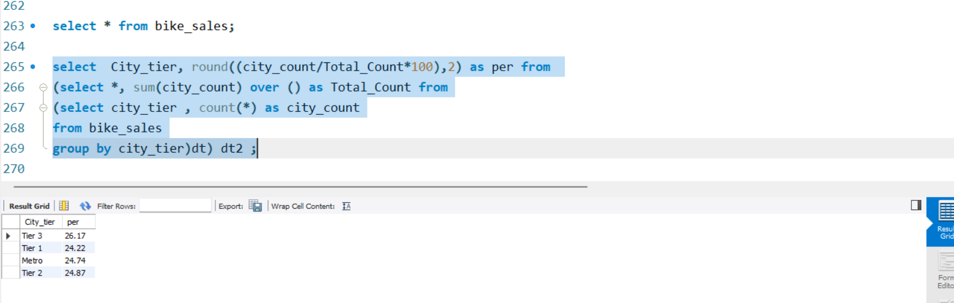
SALES ANALYST PROJECT
Get the percentage of bikes in each city tier.

Slide 7
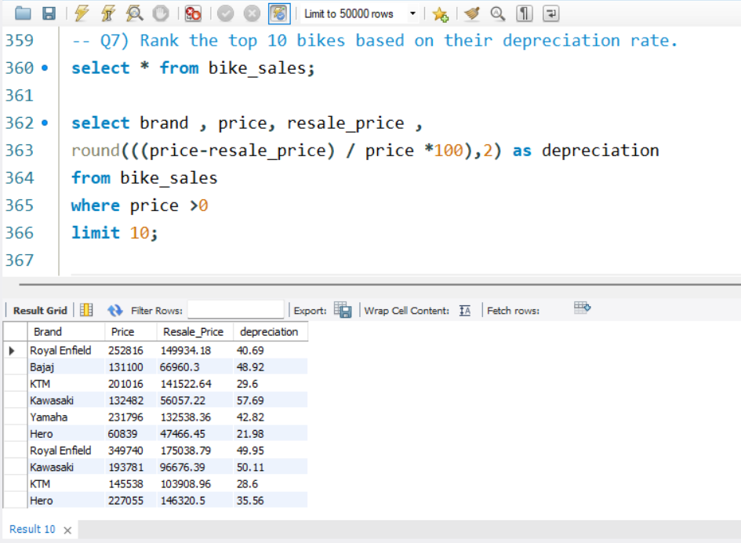
SALES ANALYST PROJECT
Rank the top 10 bikes based on their depreciation rate.

Slide 8
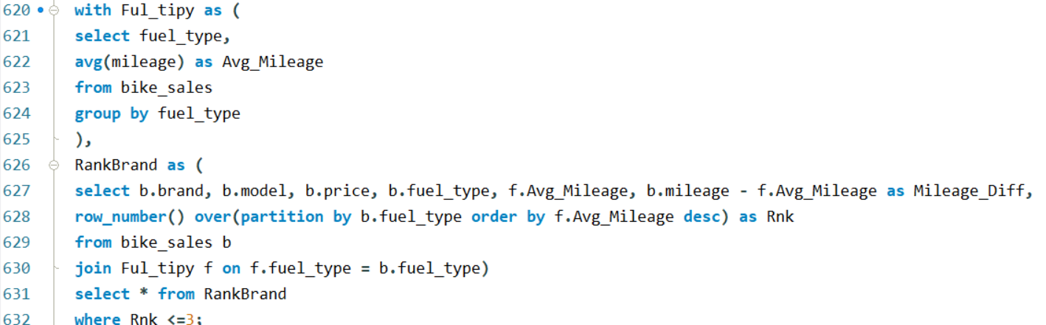
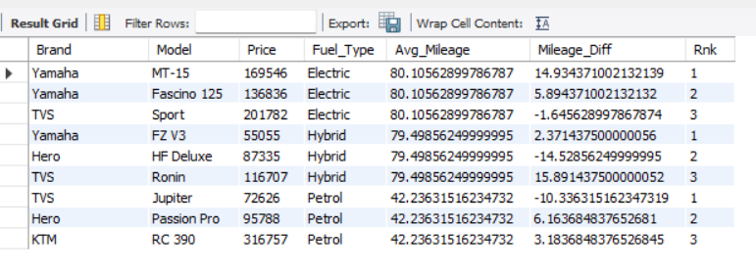
SALES ANALYST PROJECT
Display the highest mileage bike per fuel type along with its difference from the average mileage.

Slide 9
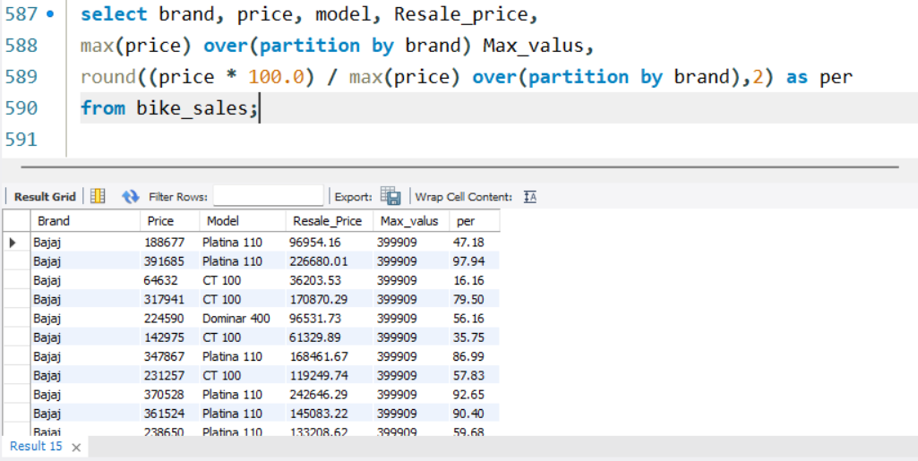
SALES ANALYST PROJECT
Calculate the percentage of each bike’s price relative to the highest-priced bike in its brand.

Slide 10
SALES ANALYST PROJECT
End the MySQL
MySQL – I Have Put Top Questions in it. If You want to see More topics of Mysql Then You can go to My Profile and See my GitHub Profile.
Share My GitHub Link.

Slide 11
SALES ANALYST PROJECT
Dashboards (Power BI)
=> Sales Overview
=> Product Performance
=> Customer Segmentation
=> Yearly Sales Trends
=> Filter By Region, Product, or Time Period
=> It is a Find KPIs and Creative & User Friendly Dashboard.
=> In This I Have Inside Value and Graphs With Pie Chart and Cluster Bar Chart and Tables and Etc Charts
=> I Have Created Three Dashboard Pages In Power BI

Slide 12
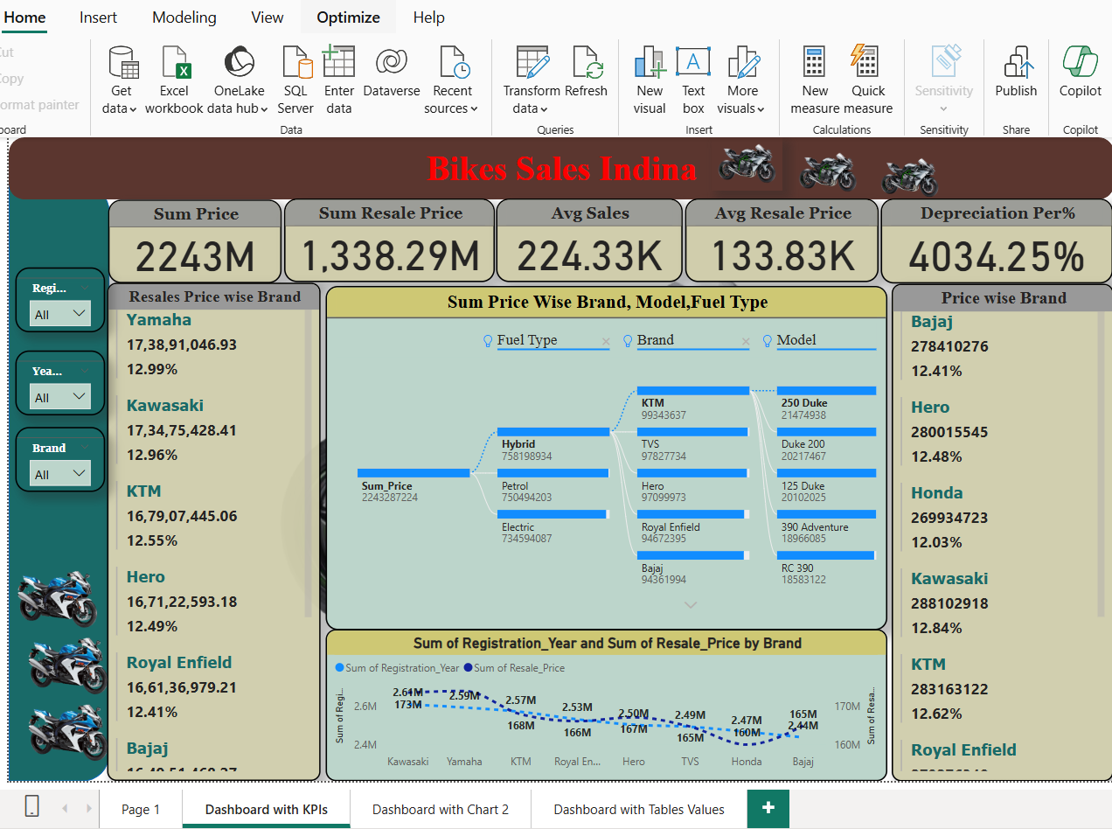
SALES ANALYST PROJECT
It Is a Dashboards and KPIs

Slide 13
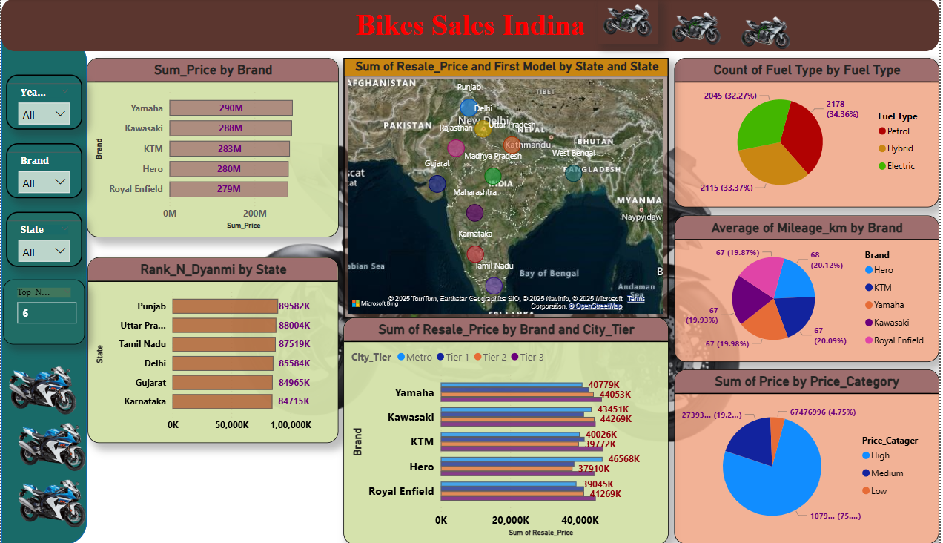
SALES ANALYST PROJECT
It is a Dashboards 2 And Graph

Slide 14
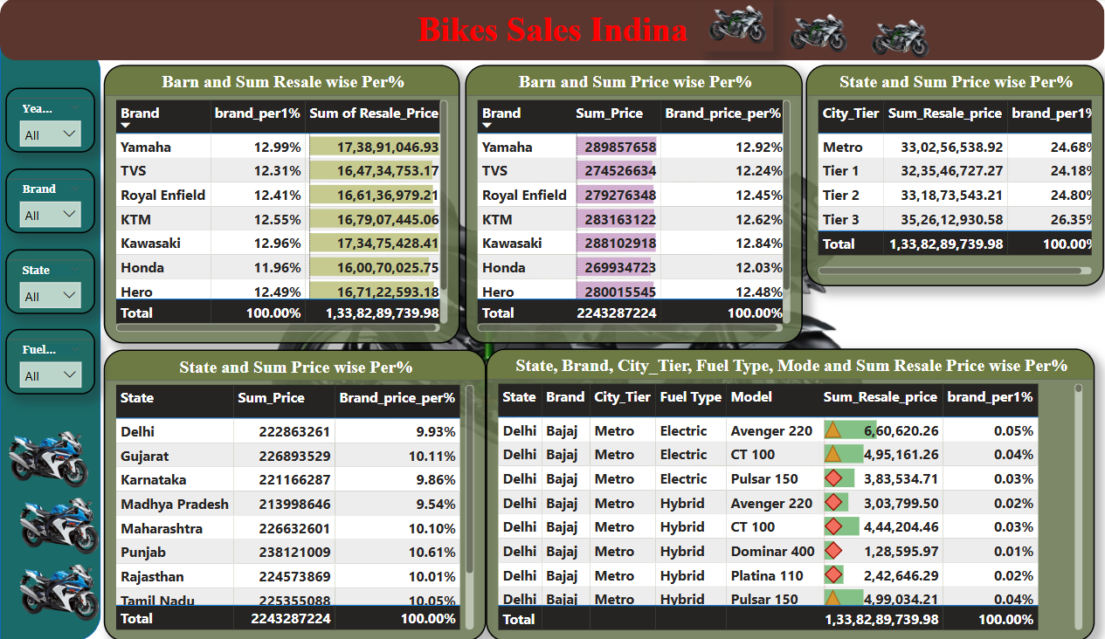
SALES ANALYST PROJECT
It is a Dashboards In Tables Values

Slide 15
SALES ANALYST PROJECT
Conclusion
Efficient Data Analyst Using MySQL + Power BI
Identified trends and actionable insights
Helped Make Data-Driven Decisions for Sales Strategy
If You Want to See My Project In Full Detail Then You Can go to My GitHub and LinkedIn Profile and See It. I Have Put it Here.
Link to Both are Give at The end of the Page.

Slide 16

SALES ANALYST PROJECT
Thank You
Name : Vikas Kumar Gupta
Role : Aspiring Data Analyst
Email : mrvikasgupta3@gmail.com
LinkedIn : Vikas_linkedin
GitHub : Vikas_GitHub
Naukri Campus : Vikas Naukri

